Slide 1
Introduction to Dataset Arrays

Slide 2
Dataset Arrays
Useful for collecting many types of related data into a single array for statistical analysis (Database applications).
Best suited to tabular or column oriented data often seen in text files or spreadsheets. The data in a single column must all be of the same type, but different columns may have different types of data (strings, doubles, integers, …).
Dataset arrays can be created from variables in the workspace or more commonly, from files (excel, text, csv).

Slide 3
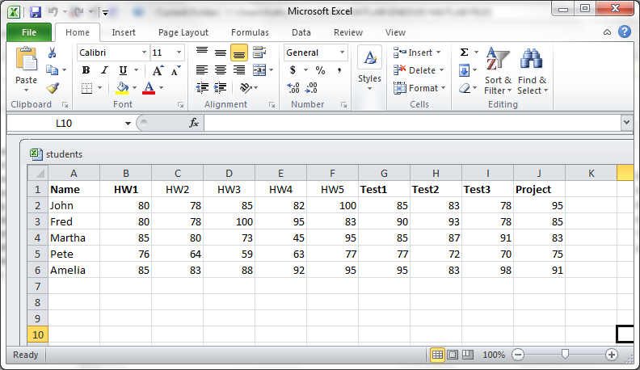
Sample Excel File
Name of the Excel File: Students.xlsx

Slide 4
Creating a Dataset Array from an Excel File
>> grade = dataset('xlsfile',‘Students')
grade =
Name HW1 HW2 HW3 HW4 HW5 Test1 Test2 Test3 Project
'John' 80 78 85 82 100 85 83 78 95
'Fred' 80 78 100 95 83 90 93 78 85
'Martha' 85 80 73 45 95 85 87 91 83
'Pete' 76 64 59 63 77 77 72 70 75
'Amelia' 85 83 88 92 95 95 83 98 91
Note: MAC users – if the dataset command doesn’t work, then save the Grade.mat file in your current folder and type >> load Grade
This will load the dataset for you.

Slide 5
Notes about Excel Files
Make sure there are no blank columns in the file. Each column must have a header (label) even if no data is present in the column.
Data in a column should all be of the same type: integer, double, or string. It is perfectly fine to have some columns that are all strings and some columns that are numerical.
All columns with numbers will be numerical vectors and all columns with strings will be cell arrays.

Slide 6
Indexing for a Dataset Array
Dataset arrays are 2-dimensional. You must specify row and column just like indexing into a matrix.
>> grade(1:2,1:5)
ans =
Name HW1 HW2 HW3 HW4
'John' 80 78 85 82
'Fred' 80 78 100 95
Note: We see rows 1 and 2 and columns 1 thru 5 here. Notice that the column headers are not considered to be row 1 but are displayed anyway which is actually quite convenient.

Slide 7
Accessing Data in a Dataset Array
In order to access data to do analysis and/or graphing, you simply refer to the column header.
>> grade.HW1
ans =
80
80
85
76
85
>> grade.HW1(4) % Grabs the only 2nd entry
ans = 76
>> max(grade.HW1) % The maximum HW1 score
ans = 85
Note:
grade.HW1 is a vector of all of the HW1 scores. It is a vector of doubles because the scores are all numbers and the MATLAB default is double for numbers.

Slide 8
Accessing Data in a Dataset Array
In order to access data to do analysis and/or graphing, you simply refer to the column header.
>> grade.Name
ans =
'John'
'Fred'
'Martha'
'Pete'
'Amelia'
>> grade.Name(2) >> grade.Name(2:3)
ans = ans =
'Fred‘ 'Fred'
'Martha'
Note:
grade.Name is a cell array of all of the student names. It is a cell array because the names are strings.

Slide 9
Applying Array Functions
Calculate the average grade on the project and the standard deviation
>> mean(grade.Project)
ans =
85.8000
>> std(grade.Project)
ans =
7.6942

Slide 10
Applying Array Functions
How many students scored above the average on the project?
>> sum(grade.Project > 85.8)
ans = 2
What are the names of these students?
>> location = find(grade.Project > 85.8)
location =
1
5
>> grade.Name(location)
ans =
'John'
'Amelia'

Slide 11
Adding Data to a Dataset Array
Add a column to the dataset array which is the average of the five homework scores for each student.
>> grade.HWAVG =
(grade.HW1+grade.HW2+grade.HW3+grade.HW4+grade.HW5)/5
Or
>> grade.HWAVG =
mean([grade.HW1 grade.HW2 grade.HW3 grade.HW4 grade.HW5],2)
% Setting the 2nd input argument to 2 in the mean function computes the average across rows rather than down the columns which is what we want.

Slide 12
Adding Data to a Dataset Array
Add a column to the dataset array which is the average of the three test scores for each student.
>> grade.TESTAVG = (grade.Test1+grade.Test2+grade.Test3)/3
Or
>> grade.TESTAVG = mean([grade.Test1 grade.Test2 grade.Test3],2)
% Setting the 2nd input argument to 2 in the mean function computes the average across rows rather than down the columns which is what we want.

Slide 13
Adding Data to a Dataset Array
Add a column to the dataset array which computes each students final course average assuming homework is worth 25%, tests are worth 45% and the project is worth 30%.
>> grade.AVG =
0.25*grade.HWAVG+0.45*grade.TESTAVG+0.3*grade.Project

Slide 14
Result of Previous Commands
>> grade
grade =
Name HW1 HW2 HW3 HW4 HW5 Test1 Test2 Test3 Project
'John' 80 78 85 82 100 85 83 78 95
'Fred' 80 78 100 95 83 90 93 78 85
'Martha' 85 80 73 45 95 85 87 91 83
'Pete' 76 64 59 63 77 77 72 70 75
'Amelia' 85 83 88 92 95 95 83 98 91
HWAVG TESTAVG AVG
85 82 86.65
87.2 87 86.45
75.6 87.667 83.25
67.8 73 72.3
88.6 92 90.85
Note: Three new columns of data added without requiring FOR loops.

Slide 15
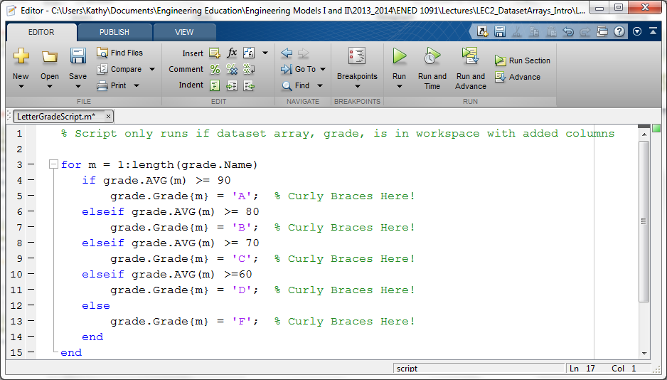
Adding A Column of Strings
Suppose we now want to add a column for letter grades. This column will be a cell array and we must use a for loop in this example.

Slide 16
Important Reminders about Cell Arrays
When creating a cell array, you must use curly braces { }
Always use curly braces { } when adding a column of strings to a dataset array
Always use curly braces { } when overwriting a string in a cell array.
Use parenthesis ( ) to index into the cell array or column

Slide 17
Adding a Column of Strings
Result of running the script file (produces a warning but does not affect the results):
>> LetterGradeScript
Warning: Observations with default values added to dataset variable 'Grade'.
> In dataset.subsasgn at 557
In LetterGrade at 6
>> grade
grade =
Name HW1 HW2 HW3 HW4 HW5 Test1 Test2 Test3 Project HWAVG TESTAVG AVG Grade
'John' 80 78 85 82 100 85 83 78 95 85 82 86.65 'B'
'Fred' 80 78 100 95 83 90 93 78 85 87.2 87 86.45 'B'
'Martha' 85 80 73 45 95 85 87 91 83 75.6 87.667 83.25 'B'
'Pete' 76 64 59 63 77 77 72 70 75 67.8 73 72.3 'C'
'Amelia' 85 83 88 92 95 95 83 98 91 88.6 92 90.85 'A'

Slide 18
Applying Array Functions
How many students earned a B in the course and who were they?
>> Num_B_students = sum(strcmp(grade.Grade,'B'))
Num_B_students = 3
>> location_B = find(strcmp(grade.Grade,'B'))
Location_B =
1
2
3
>> grade.Name(location_B)
ans =
'John'
'Fred'
'Martha'

Slide 19
Saving the Modified Dataset Array
The expanded dataset array can be saved in a MATLAB data file (.mat file) or the new columns can be added to the original excel file.
To save the expanded grade dataset array as a MATLAB datafile, simply use the save command:
>> save(‘Grades.mat','grade')
% Saves the grade dataset array in a file named Grades.mat
>> load Grades
% Loads the grade dataset array back into the MATLAB workspace

Slide 20
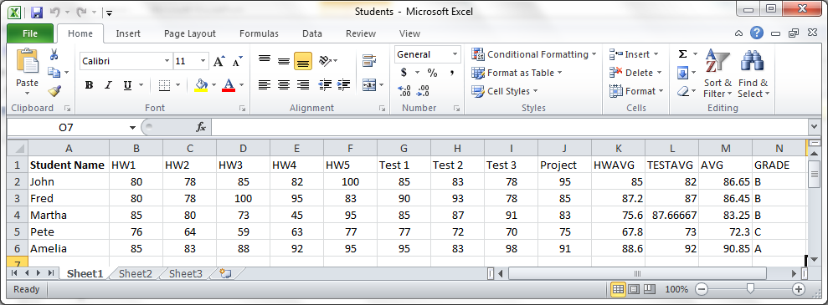
Writing Data Back to Excel
>> xlswrite('Students.xlsx',[grade.HWAVG grade.TESTAVG grade.AVG],'K2:M6');
>> xlswrite('Students.xlsx',grade.Grade,'N2:N6');
>> xlswrite('Students.xlsx',{'HWAVG' 'TESTAVG' 'AVG‘ ‘GRADE’},'K1:N1')

Slide 21
Dataset Array vs. Raw Excel Data
We can import raw data from excel into arrays in MATLAB without bothering with Dataset Arrays. For example,
>> HWGRADES = xlsread(‘Students.xlsx’,‘B2:F6’);
would create a matrix of all the HW grades.
A couple of nice things about Dataset Arrays:
Columns are labeled and we can easily use these labels to pull out data and keep track of what data is in each column – not just an array of numbers. For example, grade.HW1 is a vector of all HW1 grades. This is probably easier to remember than HWGRADES(:,1).
Strings are much easier to pull in. xlsread will put all numerical data in one array and all string data in a cell array. If you have intermixed columns of numerical data and strings, it can be really hard to keep straight where things are without using a Dataset Array.

